Slide 1
Flint
A Programmable Style and Documentation Linter for Java
Ofek Inbar, Daniel Wang, Elliott de Bruin, Jessica Chen

Slide 2
Motivation
Developers want tools that are easy to learn and begin using in a short amount of time
Using Java for configuration gives the user more control than using XML
Option to run resource intensive checks under defined conditions
Developers want to be able to create and develop clean and readable codebases without needing to manually check their code against their style guide

Slide 3
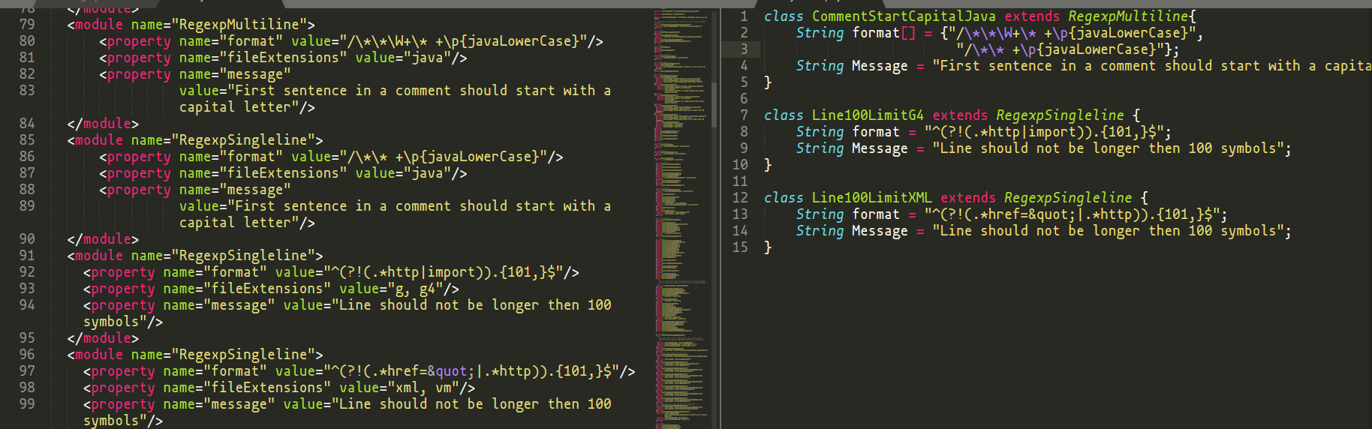
Motivation

Slide 4
Approach
One configuration file defines the linter’s behavior
One file is easy for users to understand, makes setup easier
Configuration is written in Java, this gives the user total control over the linter’s behavior, from defining which rules are checked in what order and under what conditions
Offer both Command Line Interface and IDE extension
Command line is useful for people who don’t use IDE’s, and provides more control over when to lint
IDE extension speeds up workflow (don’t need to switch applications or contexts to run linter)

Slide 5
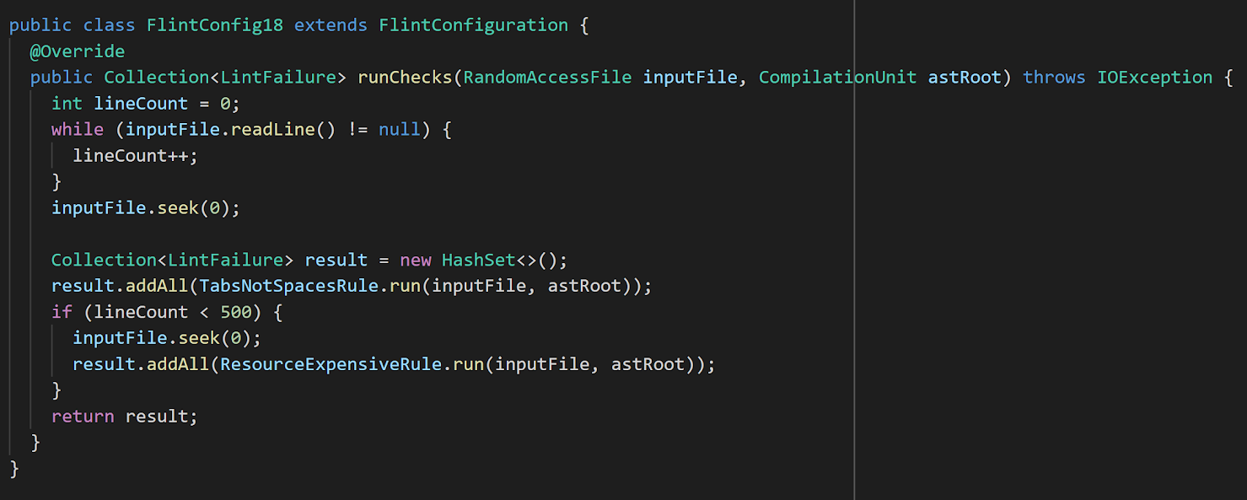
Approach

Slide 6
Research Questions
Tools that bring milder learning curve
e.g. Java vs. XML, various linter definitions
Functionality of existing tools
How people love and hate about them?
What developers would like to get out of program analysis?
XML and Java Trade-offs
Notes:
research questions: What are your hypotheses?
What is your methodology?
What information will you try to gather?
What metrics will you measure?
How are those related (whether directly or indirectly) to the real-world problem?
What are the threats to validity of your results — that is, the ways that your your experiments may not be representative of the real world?

Slide 7
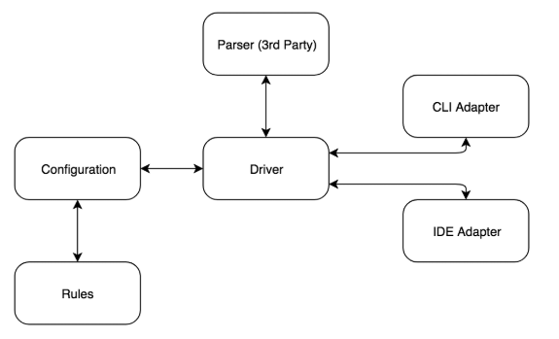
Preliminary Results

Slide 8
Preliminary Results
CLI Version Done
CLI Adapter Implemented and Tested
Driver being able to connect rules and CLI Adapter
CI tools are powerful and unexpectedly easy to use!

Slide 9
Related Tools
Checkstyle
Able to customize style checks
Configuration must be done in XML
Comes with pre-written checks
Google-java-format
Style checker for Google’s style guide
Not easily customizable
Able to automatically fix errors
Error Prone
Hooks into your applications compile step
Catches common programming mistakes at runtime and provides suggested fixes
Uncrustify
Code formatter with 655 configurable options
Does not have rule customization support

Slide 10
Works Cited
“Checkstyle – Checkstyle 8.17.” Checkstyle, 27 Jan. 2019, checkstyle.sourceforge.net/.
“google/google-java-format: Reformats Java source code to comply with Google Java style.” Google, 10 Jan. 2019, github.com/google/google-java-format/.
Maria Christakis , Christian Bird, What developers want and need from program analysis: an empirical study, Proceedings of the 31st IEEE/ACM International Conference on Automated Software Engineering, September 03-07, 2016, Singapore, Singapore [doi>10.1145/2970276.2970347]
“Uncrustify: Source Code Beautifier for C, C++, C#, ObjectiveC, D, Java, Pawn and VALA.” Uncrusify. Feb. 2019, http://uncrustify.sourceforge.net/
“Error Prone.” Google, Feb 2019, https://errorprone.info/

